Slide 1

Car prices Data Analysis – Module 1
An overview of dataset analysis using Dask.
By
Shobharani

Slide 2
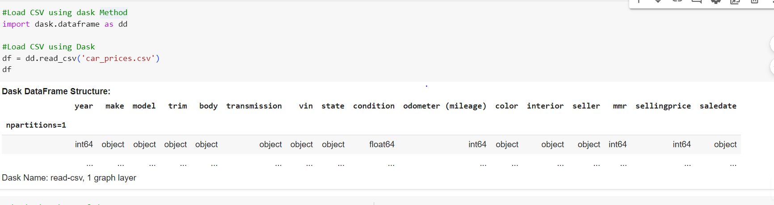
Loading CSV Data using with Dask
To load data using Dask, use the read_csv method:
import dask.dataframe as dd Load CSV using Dask
df = dd.read_csv('car_prices.csv')
df

Slide 3
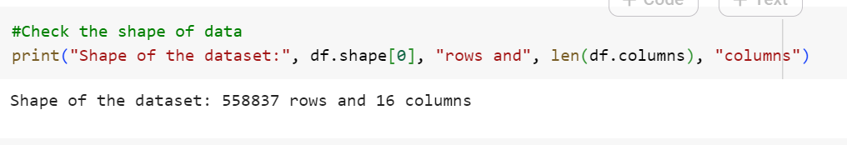
Data Shape
The shape of the dataset can be obtained using df.shape. This provides the number of rows and columns.
print("Shape of the dataset:", df.shape[0], "rows and", len(df.columns), "columns")

Slide 4
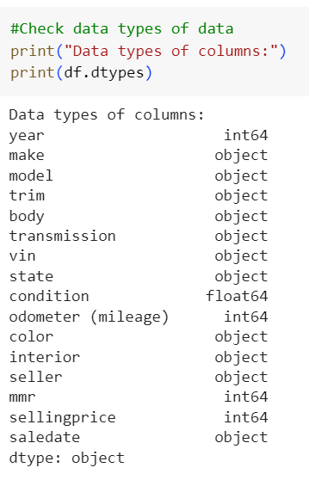
Data Types
Data types of the dataset can be listed using df.dtypes, which shows the type for each column.

Slide 5
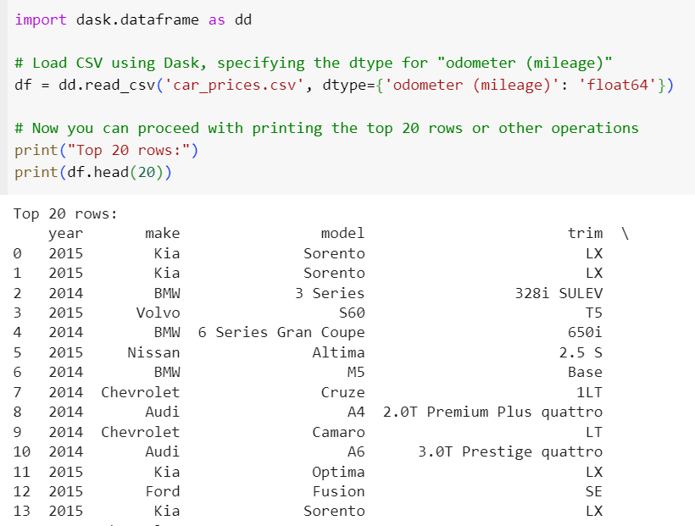
Top 20 Rows
Display the top 20 rows of the dataset using df.head(20).

Slide 6
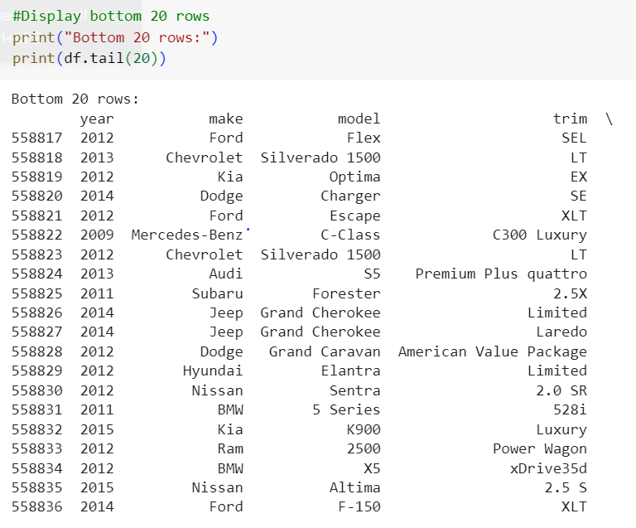
Bottom 20 Rows
Display the bottom 20 rows of the dataset using df.tail(20).

Slide 7
Hypotheses
Hypothesis 1: Car price correlates positively with the number of cylinders.
Null Hypothesis (H0): There is no correlation between car price and the number of cylinders.
Alternate Hypothesis (H1): There is a positive correlation between car price and the number of cylinders.
Hypothesis 2: Cars with higher horsepower tend to have higher prices.
Null Hypothesis (H0): There is no correlation between car price and horsepower.
Alternate Hypothesis (H1): There is a positive correlation between car price and horsepower.
Hypothesis 3: Fuel efficiency (mpg) negatively correlates with price.
Null Hypothesis (H0): There is no correlation between car price and fuel efficiency (mpg).
Alternate Hypothesis (H1): There is a negative correlation between car price and fuel efficiency (mpg).

Slide 8
Hypothesis
Hypothesis 4: Cars from certain brands (e.g., luxury brands) have higher average prices.
Null Hypothesis (H0): There is no difference in average prices between luxury and non-luxury car brands.
Alternate Hypothesis (H1): Luxury car brands have a higher average price compared to non-luxury brands.
Hypothesis 5: The age of the car (model year) inversely affects the price.
Null Hypothesis (H0): There is no correlation between car price and model year.
Alternate Hypothesis (H1): There is a negative correlation between car price and model year (older cars are cheaper).

Slide 9
Classification or Prediction Experiment
Prediction:
I would suggest a prediction experiment focusing on car price prediction.
Here's why:
Reasons for Prediction: Continuous Target Variable: The target variable you're interested in, "sellingprice," is continuous (numerical values).
Classification is typically used for categorical target variables (e.g., predicting if a car is "luxury" or "non-luxury").
Prediction is better suited for estimating continuous values like price.
Granular Insights: Predicting the actual selling price provides more granular and actionable insights than simply classifying cars into categories. Knowing the estimated price allows for better decision-making in buying, selling, or pricing strategies.

